Slide 1
The Phylogenetic and Taxonomic Classification of the Tarsier (Tarsiiformes)
Hannah Brown

Slide 2
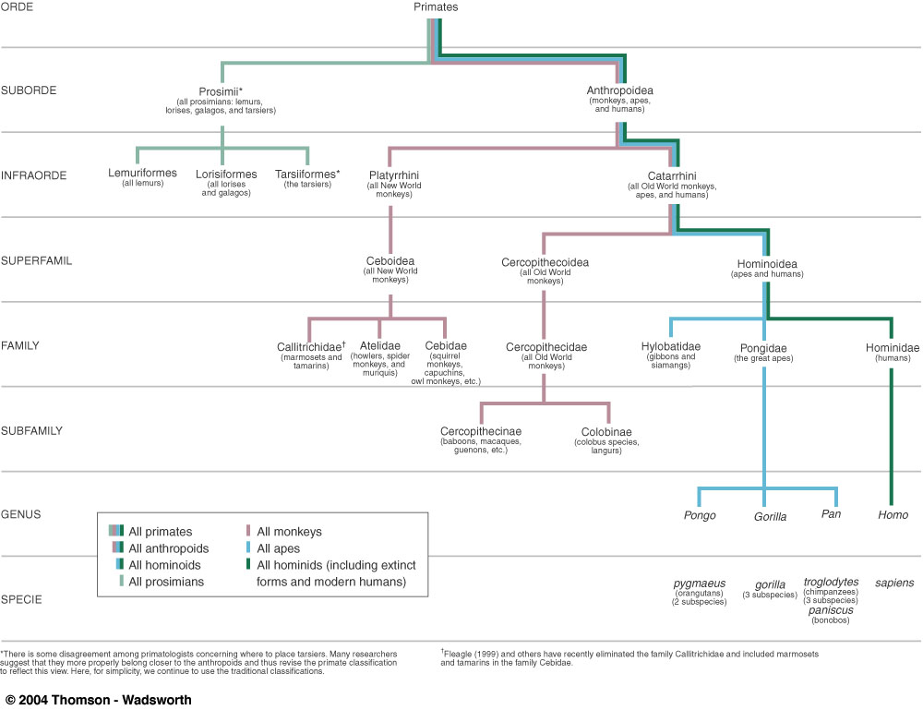

Slide 3
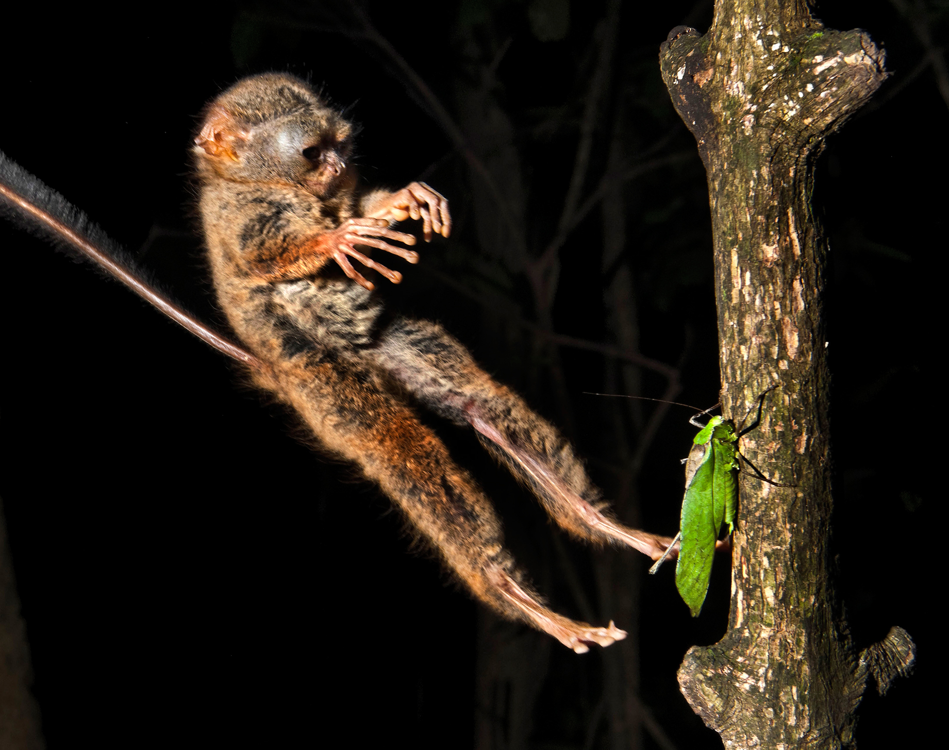
The Tarsier (Tarsiiformes)
Ancestral
Nocturnal
SE Asia

Slide 4
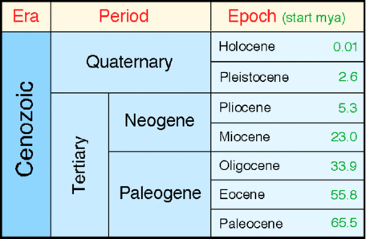
Omomyid

Slide 5
How and why should the tarsier be classified?

Slide 6
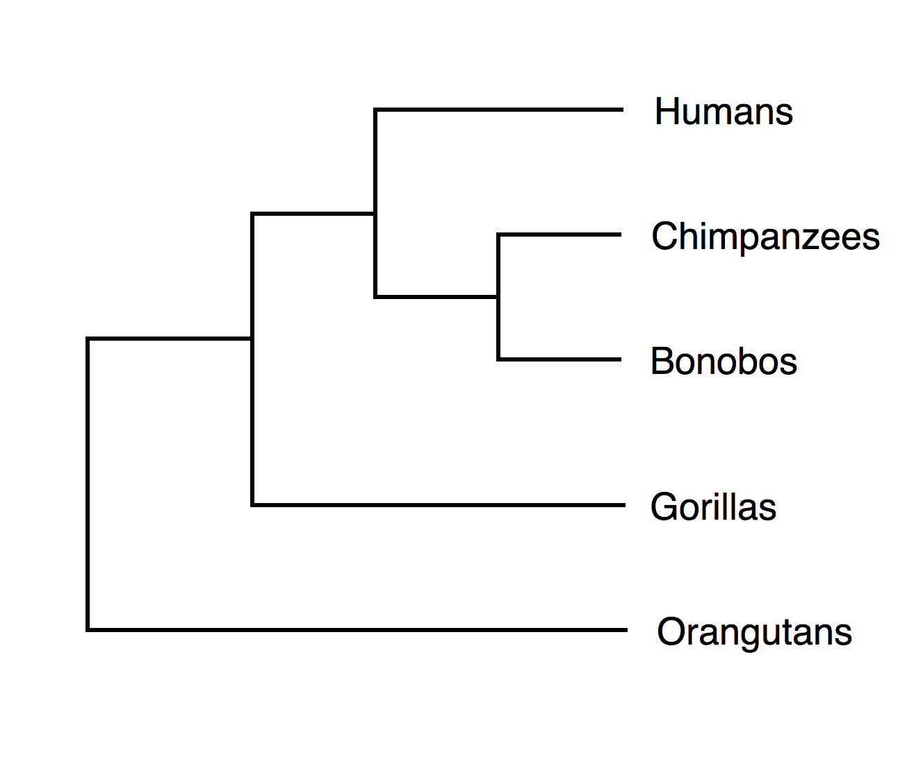
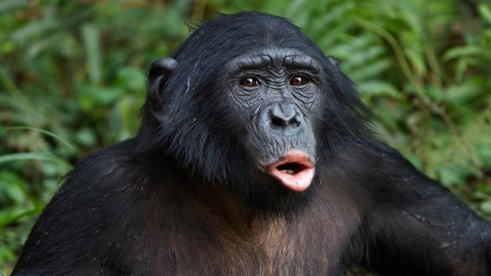
Phylogeny

Slide 7
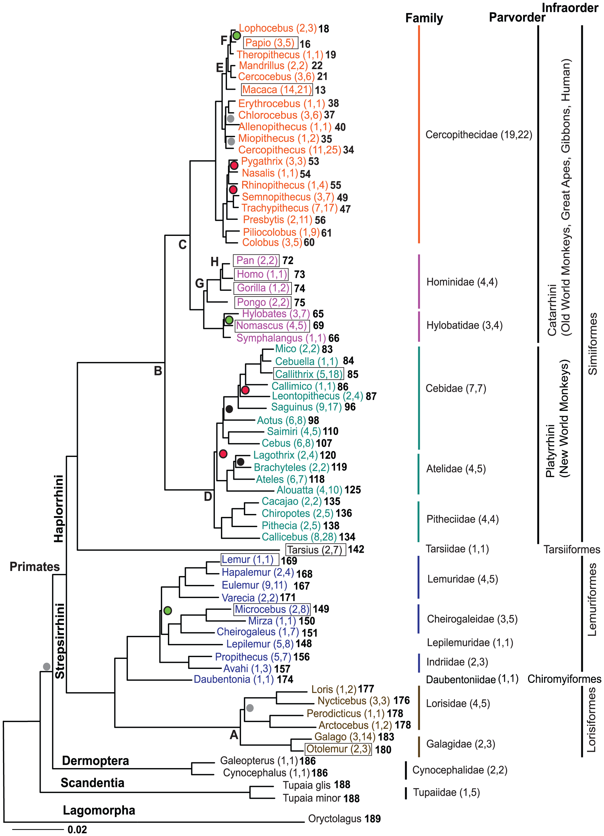
Phylogeny

Slide 8
Taxonomy
Kingdom | Animalia
Phylum | Chordata
Class | Mammalia
Order | Primates
Suborder | Anthropoidea
Infraorder | Tarsiiformes
Family | Tarsiidae
Genus | Tarsius

Slide 9
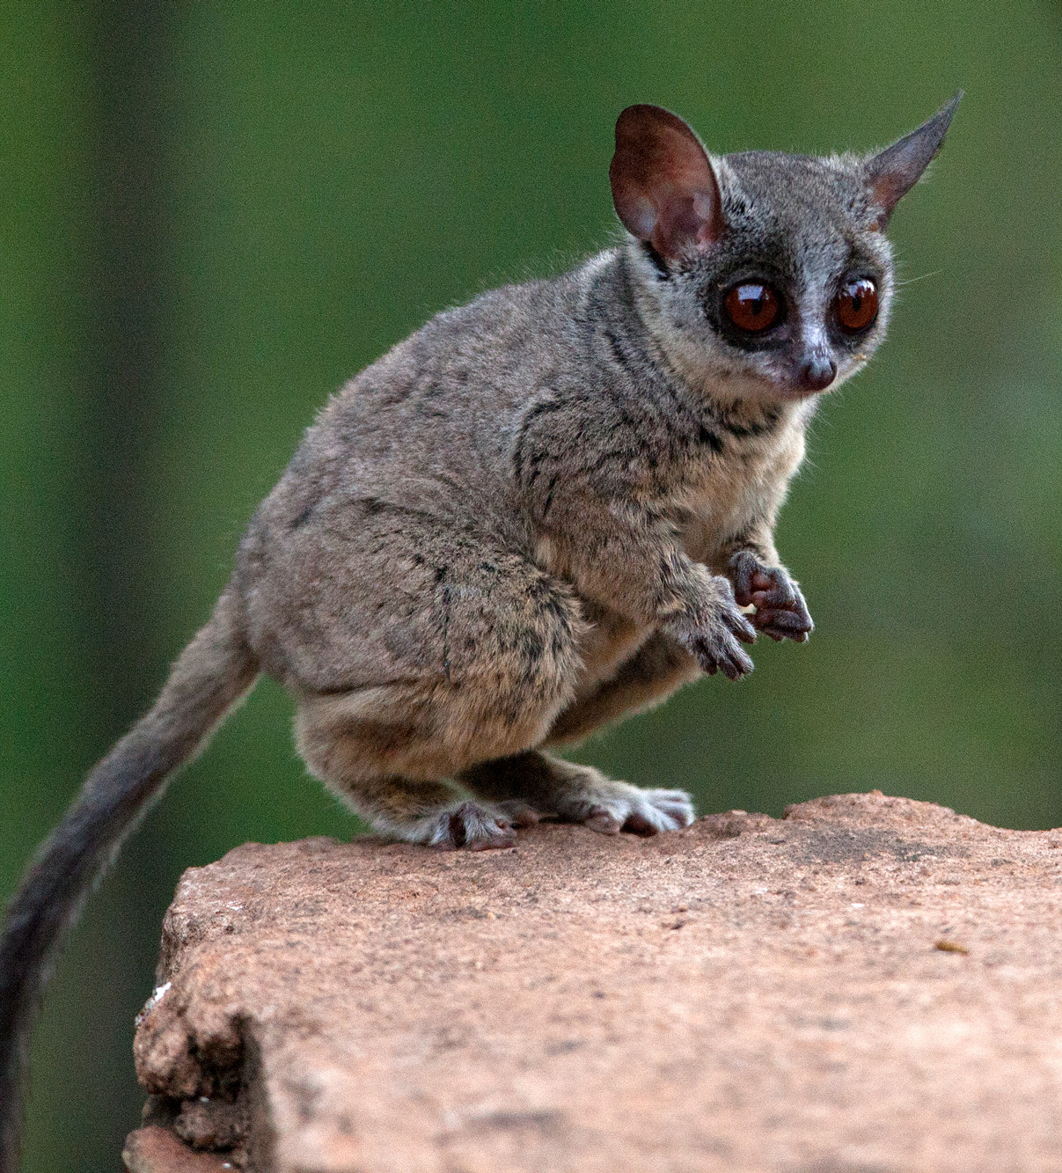
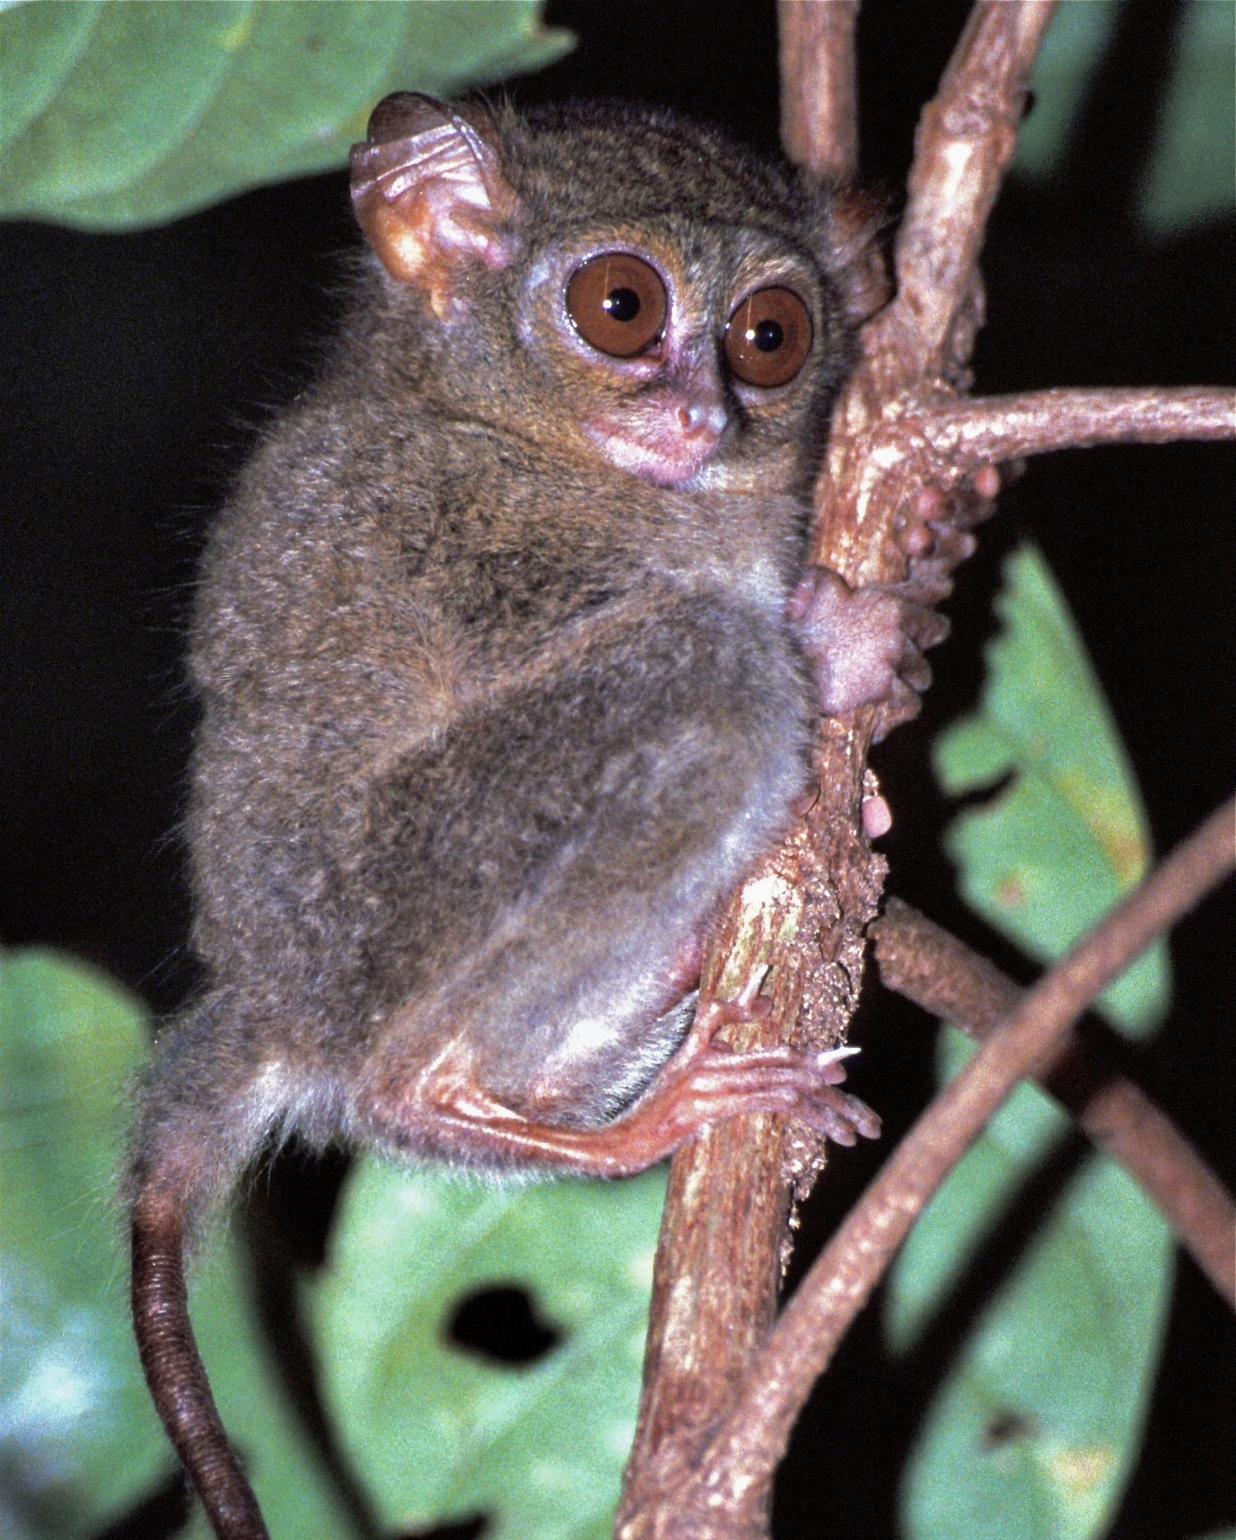
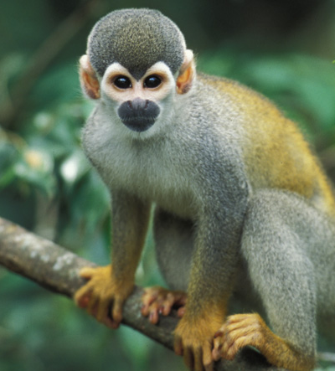
Initial Thoughts: Prosimian

Slide 10
New Findings: Anthropoid
Dry rhinarium
Hemochorial placenta
External auditory meatus
Retinal fovea
Olfactory nerves
Partially enclosed postorbital plate
DNA

Slide 13
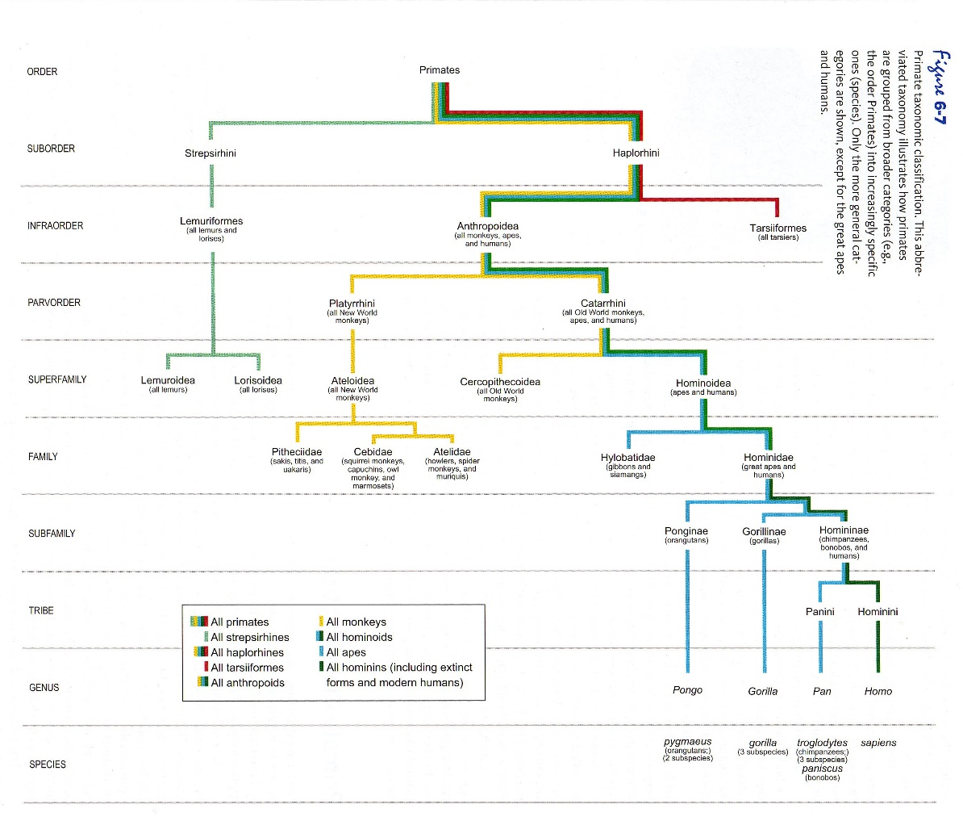
New Findings: Anthropoid

Slide 14
Future Research
DNA analysis
Field studies
Fossils

Slide 15
Works Cited
References:
Ankel-Simons, F. (2007). Primate Anatomy. Academic Press.
Campbell et al. ( 2007). Primates in Perspective. Oxford University Press: New York.
Fleagle, J. G. (1988). Primate Adaptation and Evolution. Academic Press.
Gron, K. (2010). Primate Factsheets: Tarsier (Tarsius) Taxonomy, Morphology, & Ecology. Retrieved from http://pin.primate.wisc.edu/factsheets/entry/tarsier
Hartig, et al. (2013). Retrophylogenomics Place Tarsiers on the Evolutionary Branch of Anthropoids. Science Reports, 3: 1756.
Jurmain, et al. (2013). Introduction to Physical Anthropology. Cengage Learning.
Stanford, et al. (2013). Biological Anthropology. Pearson.
Photos:
Jurmain, et al. (2016). Essentials of Physical Anthropology. Cengage Learning.
Lewis, et al. (2013). Cengage Advantage Books: Understanding Humans: An Introduction to Physical Anthropology and Archaeology. Cengage Learning.
Juergen Freund/Caters News
Martin, R. & Ross, C. (2006). The Evolutionary and Ecological Context of Primate Vision. The Primate Visual System: A Comparative Approach, pp. 1-36.
Schmitz, J., Noll, A., Raabe, C. et al. Genome sequence of the basal haplorrhine primate Tarsius syrichta reveals unusual insertions. Nat Commun 7, 12997 (2016). https://doi.org/10.1038/ncomms12997.
https://www.google.com/search?q=tarsier&rlz=1C1AJZK_enUS807US807&tbm=isch&source=iu&ictx=1&fir=ZC3TIBA4C1StYM%253A%252CkQRkc5MahmPhDM%252C_&vet=1&usg=AI4_-kSV0GZ-8vsI0lnAXgFflFsrqLHFPA&sa=X&ved=2ahUKEwji08us5J3oAhXOVt8KHUfZDMUQ_h0wAnoECAgQCA#imgrc=ObVqJEpadttuEM
https://magazine.africageographic.com/weekly/issue-268/bushbabies-southern-lesser-galago/
https://eol.org/pages/127526
https://www.britannica.com/animal/tarsier
http://www.maryanningsrevenge.com/2013/06/a-moment-of-silence-for-omomyids.html
https://serc.carleton.edu/eslabs/climatedetectives/5b.html
https://journals.plos.org/plosgenetics/article?id=10.1371/journal.pgen.1001342

